Slide 1
air traffic passenger statistics
Excel Project
My link:

Slide 2
Problem Statement :
Q1.Maximum passanger in which year?
Q2.Calculate the total passenger in may 2006?
Q3.Find the Airline IATA code and Geo summery of Airline?
Q4.calculate year vice adjusted passanger count?
Q5.Calculae the Us Airlines Low Fare Passangers?
Q6.Find the list of Adjusent passangerof enplaned in year 2005?
Q7.Determine the passanger with airlines?

Slide 3
About :
Providing the reports and management information your organization needs to plan, convince, and choose strategic directions, depends on having detailed, accurate traffic statistics over the long term, that you can analyze and pull together in numerous ways. Percentage changes only inform at a given moment in time. Scheduled capacity only tells you what might have been. With disparate sources of data that evolve over time, trends can become distorted, and models may no longer apply. Monthly Traffic Statistics provides you with a realistic picture of air traffic, from market overview to regional and airline level, collected directly from airlines.
Dataset row is 150008 and column is 16.
My link: https://drive.google.com/file/d/1cFs8m2S6il73rRjcwQaGb7Y70zpuW5YY/view?usp=sharing

Slide 4
Airlines Total passengers
Row Labels | Sum of Passenger Count
2005 | 305087
2006 | 686118
2007 | 636946
2008 | 641005
2009 | 599886
2010 | 595388
2011 | 585198
2012 | 850434
2013 | 834049
2014 | 995523
2015 | 1002438
2016 | 266515
Grand Total | 7998587

Slide 5
Airlines passenger details
Airlines passenger list
Airlines Graph:
Row Labels | Sum of Passenger Count
American Airlines | 1719412
American Eagle Airlines | 55939
SkyWest Airlines | 1209416
United Airlines - Pre 07/01/2013 | 5661523
Grand Total | 8646290

Slide 6
Passenger count month vise :
Year | 2009
Row Labels | Sum of Passenger Count
January | 2644539
February | 2359800
March | 2925918
April | 3024973
May | 3177100
June | 3419595
July | 3649702
August | 3650668
September | 3191526
October | 3249428
November | 2971484
December | 3074209
Grand Total | 37338942

Slide 7
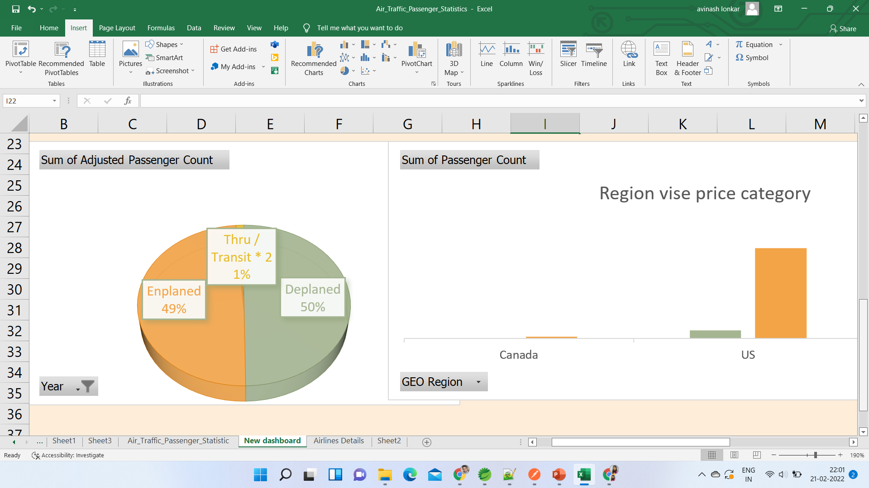

Slide 8
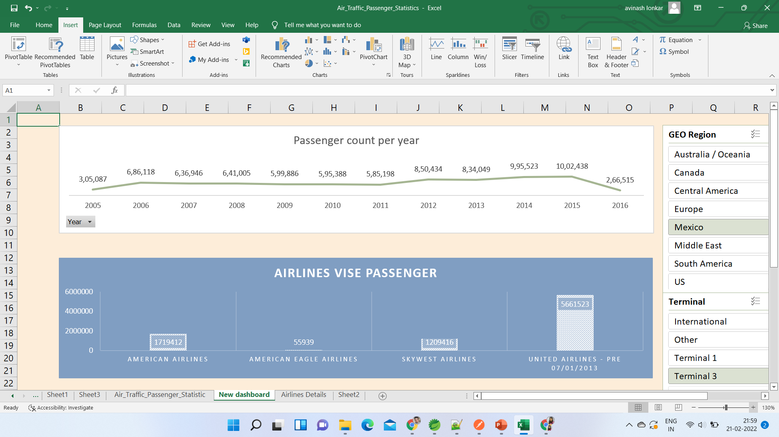

Slide 9
CONCLUSION:
1.top airlines is united airlines.
2.2015 is highest passanger count
3.pricewise is US region is highest.

Slide 10
Thank you

